Slide 1
A million metaorder analysis of market impact on the Bitcoin J. Donier and J. Bonart, 2015
A report by Yu Sun & Hongchao Pan

Slide 2
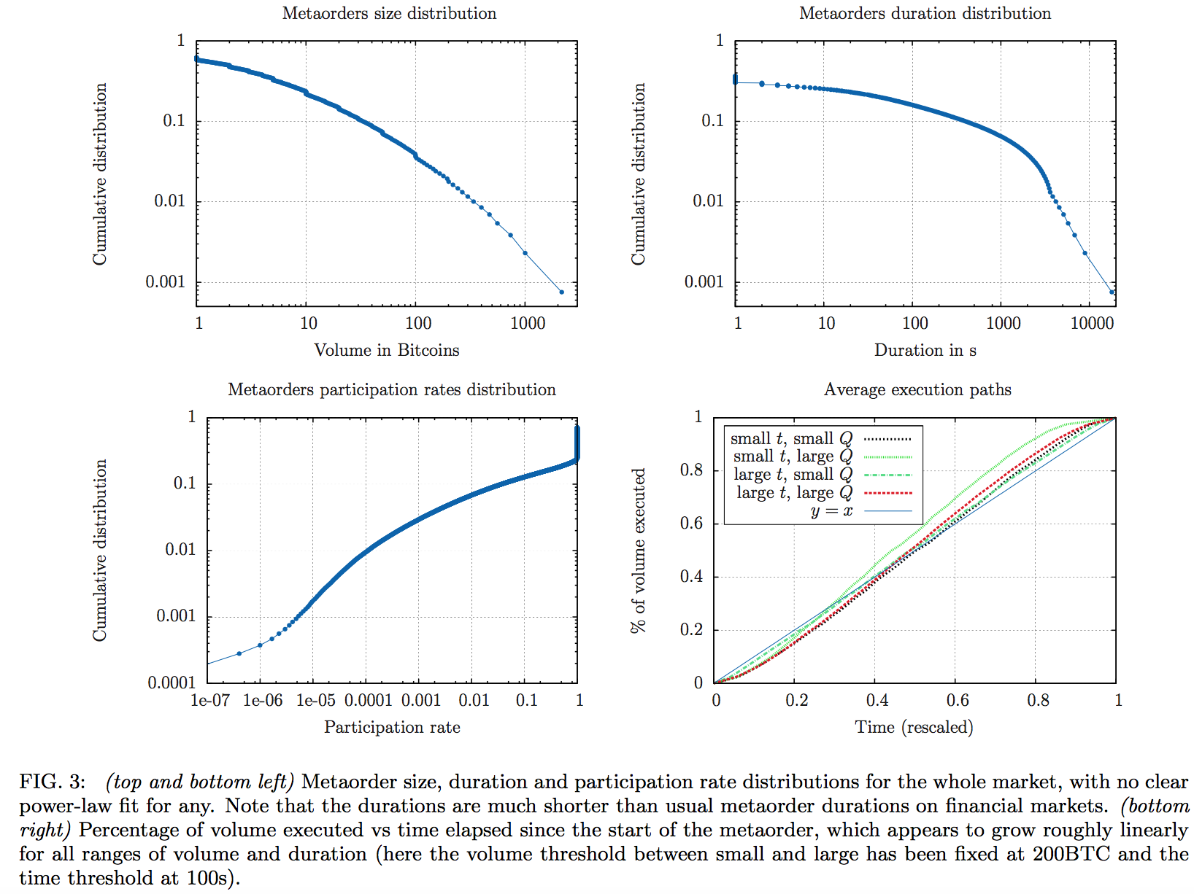
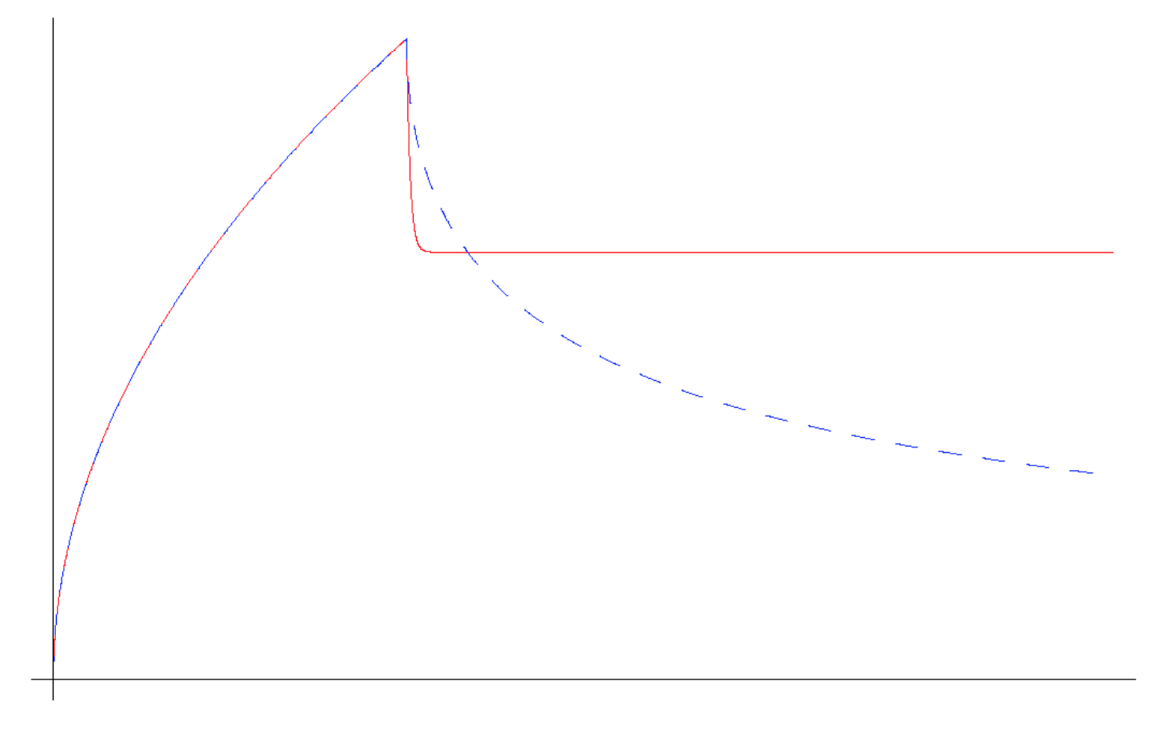
Data
Power-law decay?
Anonymous source: 13~14M trades with 1M uniquely identified (08/2011-11/2013)
Claim: Largest and complete market on Bitcoin so far
Presenting Points
Long-term power-law decay?
Square-root law?
Y-ratio
Permanent impact?

Slide 3
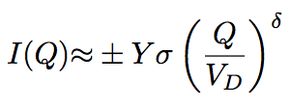

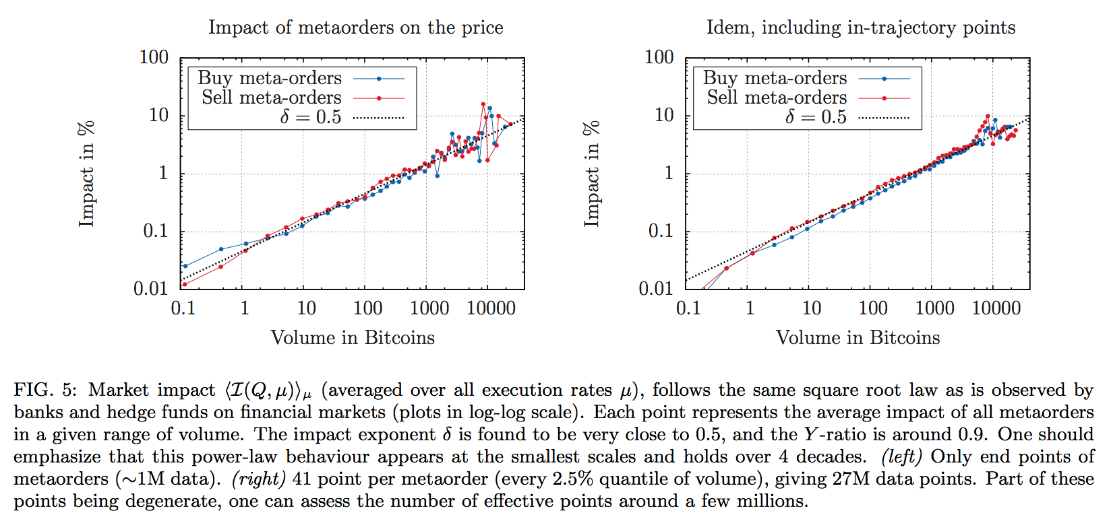
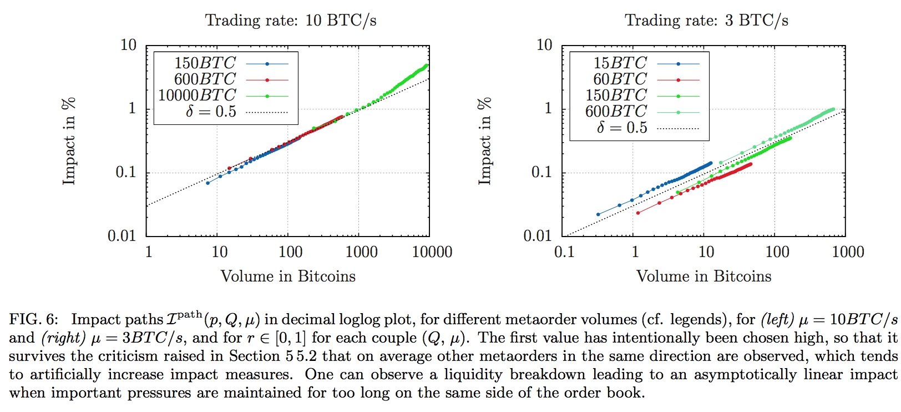
Square-root law?
Execution speed is constant
Peak impact is consistent with square root law
Y-ratio: ~0.9 close to “mature” financial markets
Square root impact trajectories
Brokmann 2014 and Toth 2011a
Notes:
Section 4.1 & 4.2 in the paper
Y: Y-ratio
Sigma: Daily vol
V_D: daily volume
Delta: ~0.5
Square-root impact trajectories: The square root law is clearly confirmed as it even holds trajectory-wise and is exact even at the smallest scales (peak impact)

Slide 4
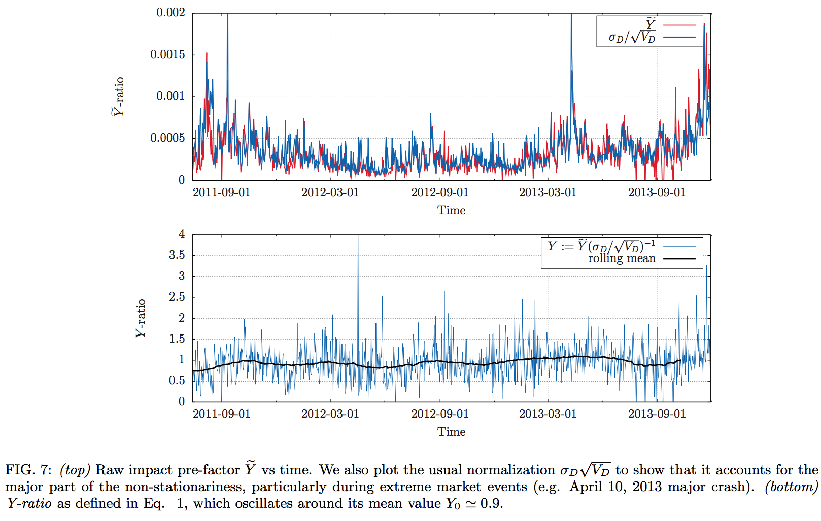

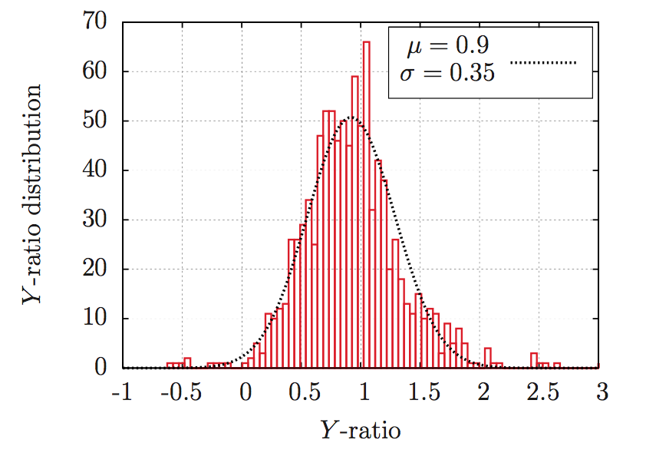
Y-ratio
Less studies on pre-factor or Y-ratio
Non-stationariness of Pre-factor is well encoded in the ration
Y-ratio is normal distributed
Grinold and Kahn 2000, Torre 1997, and Toth 2011a
Notes:
2nd bullet point validates the citation (3 papers)
Section 4.3 in the paper

Slide 5

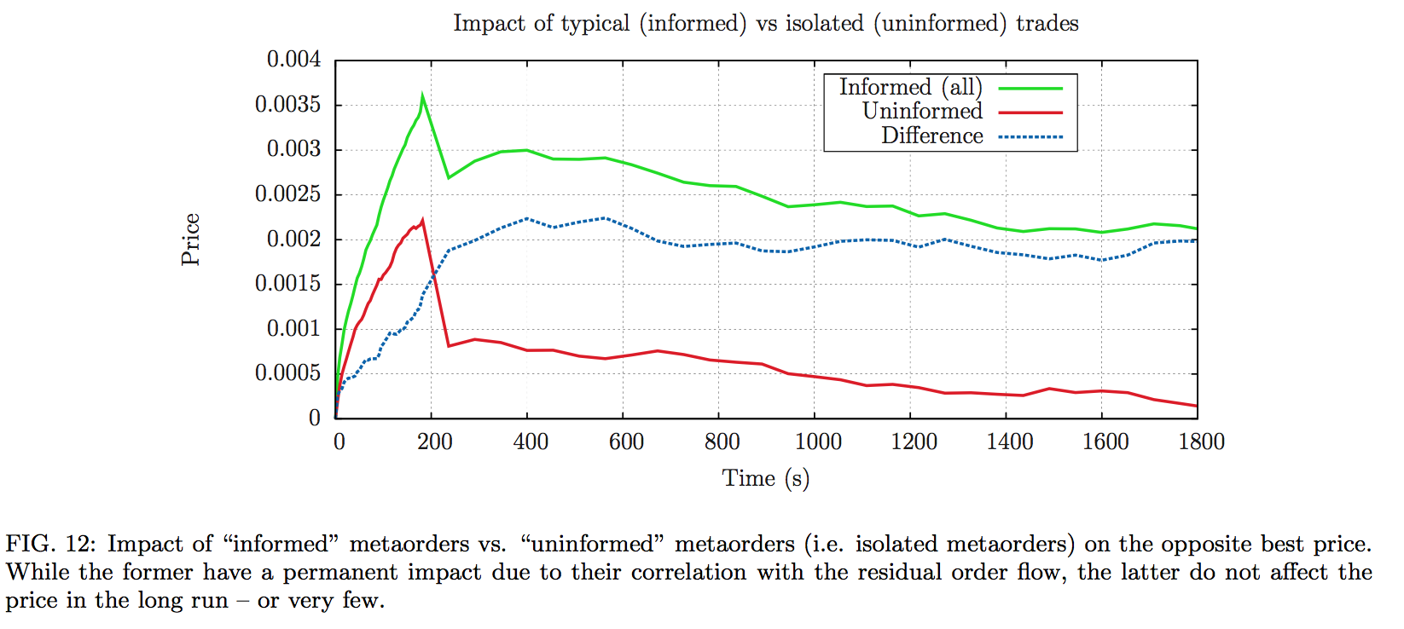
Permanent impact?
Informed: positively correlated to the rest of the market
Uninformed: uncorrelated
Permanent impact of uninformed order is 0 or very small
Mechanical peak impact
Gomes and Waelbroeck 2015
Notes:
Section 5.3 in the paper

Slide 6




Questions?

